Slide 1

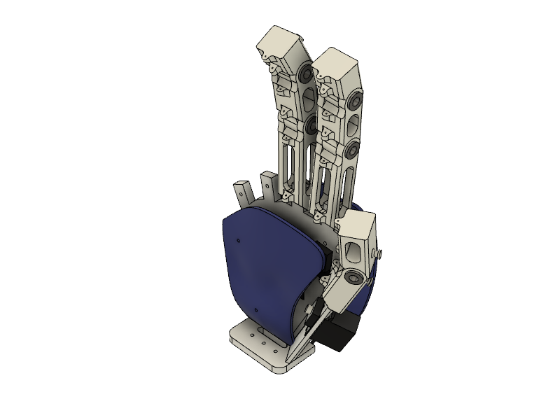
Shadow Hand
A 3 DoF animatronic hand
MEGN 540 - Team 2
Ramprasad Rajagopalan
Bhuvan Tej Kanigiri
Notes:
‹#›

Slide 2
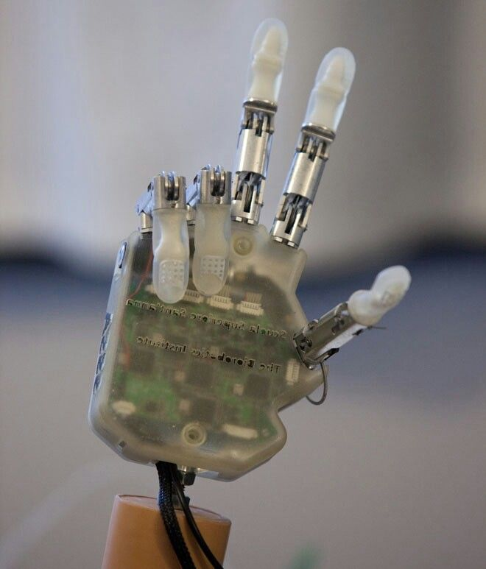
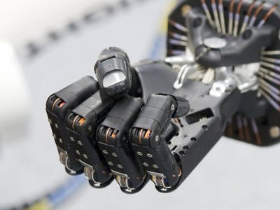
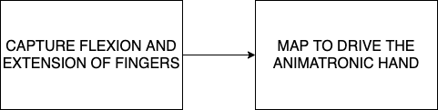
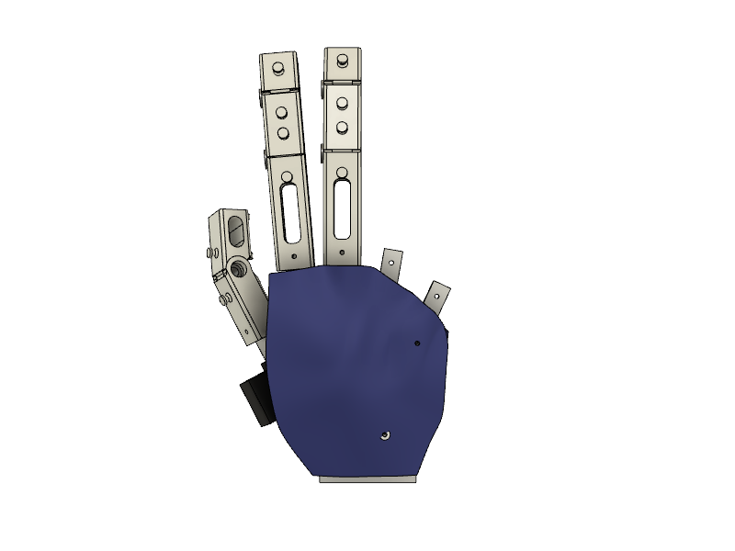
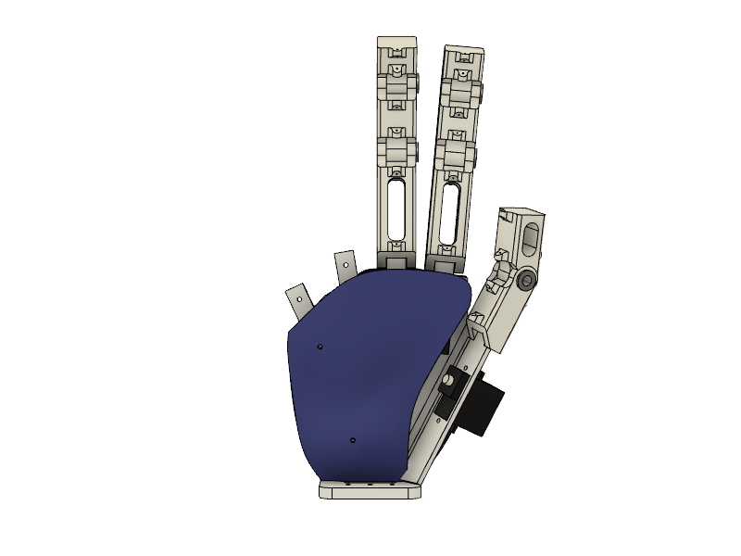
Design Problem
OBJECTIVE: DESIGN, FABRICATE AND CONTROL A 3 DoF ANIMATRONIC HAND USING FLEX SENSOR GLOVE
[1]
APPLICATION:
Teleoperation
Prosthetics
[1] Google stock images

Slide 3
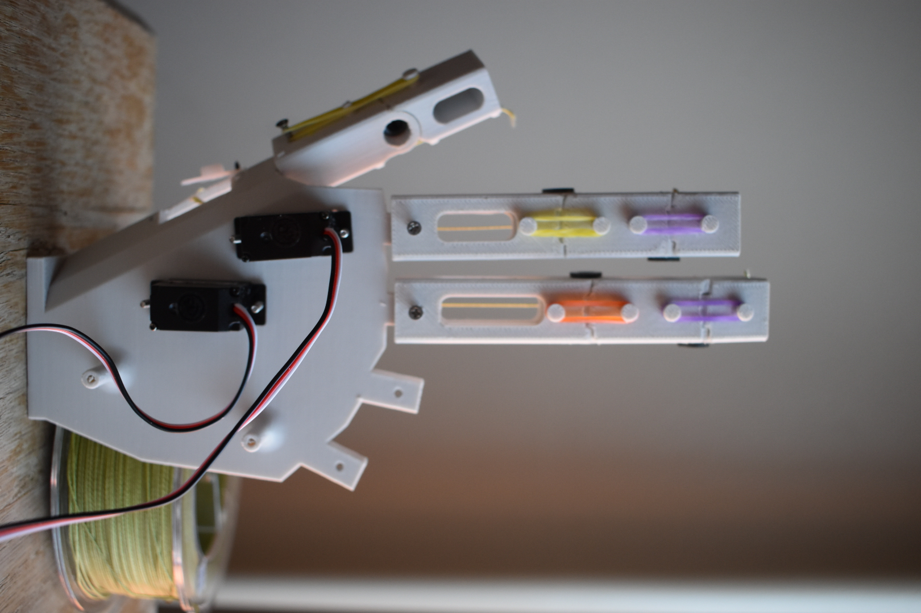
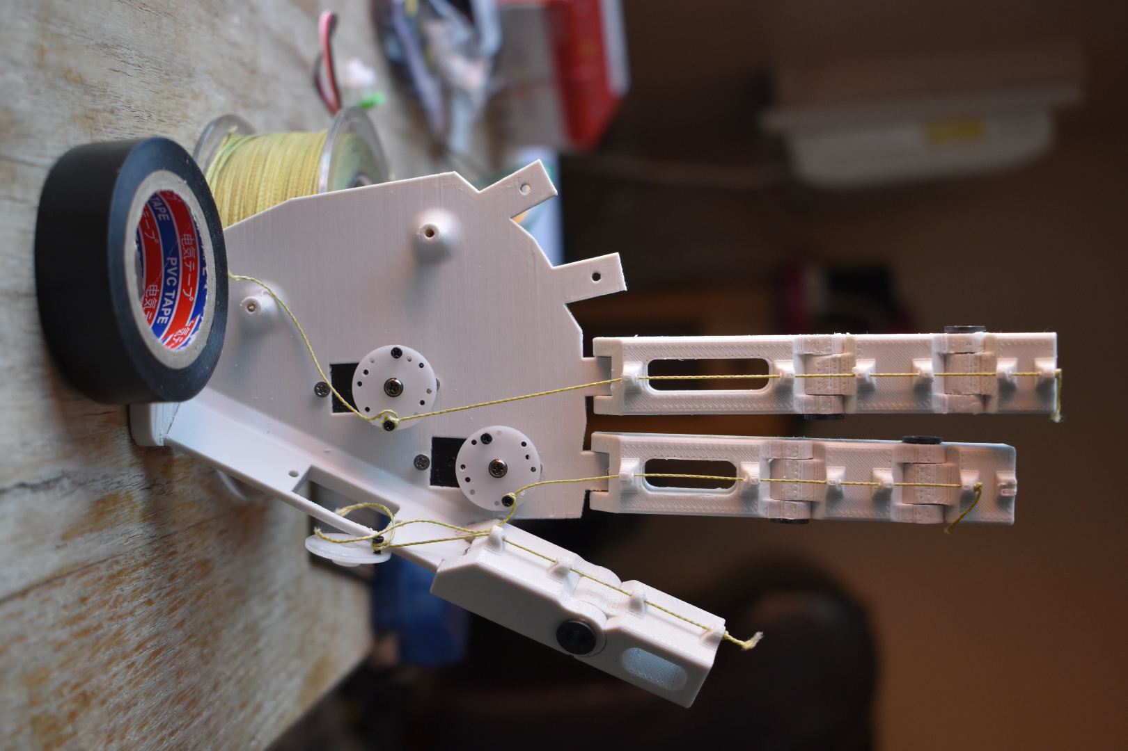
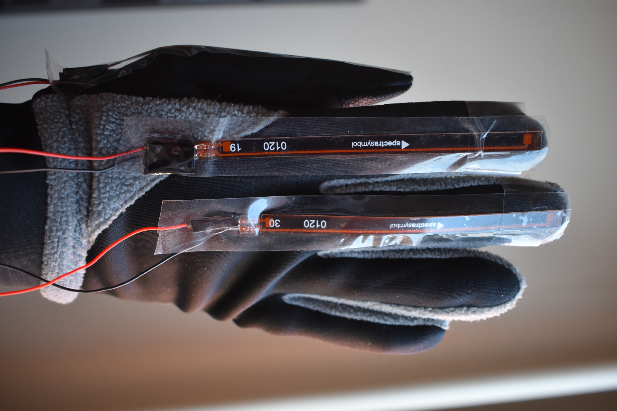
Overview of the solution
Rubber bands - antagonist
Flex Sensor
data at
100 Hz
Distal
phalange
Intermediate
phalange
Middle finger
Proximal
phalange
Arduino microcontroller
Palm/Finger mount
Glove
Micro servo motors with 20ms input PWM
3 DoF animatronic hand - dorsal side
Fishing wire
3 DoF animatronic hand - palmer side
Right hand glove worn by human operator

Slide 4
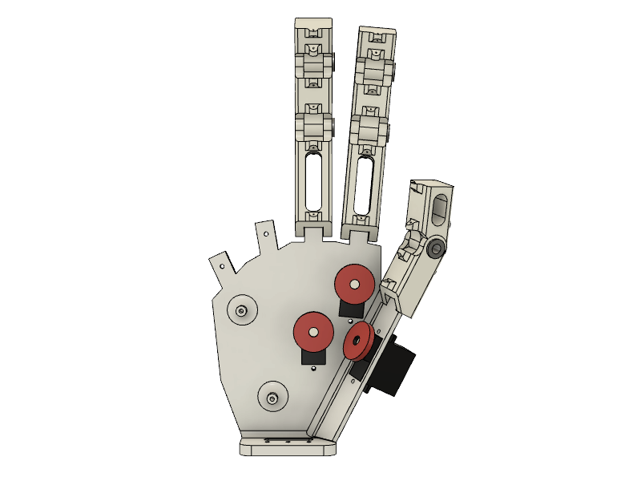
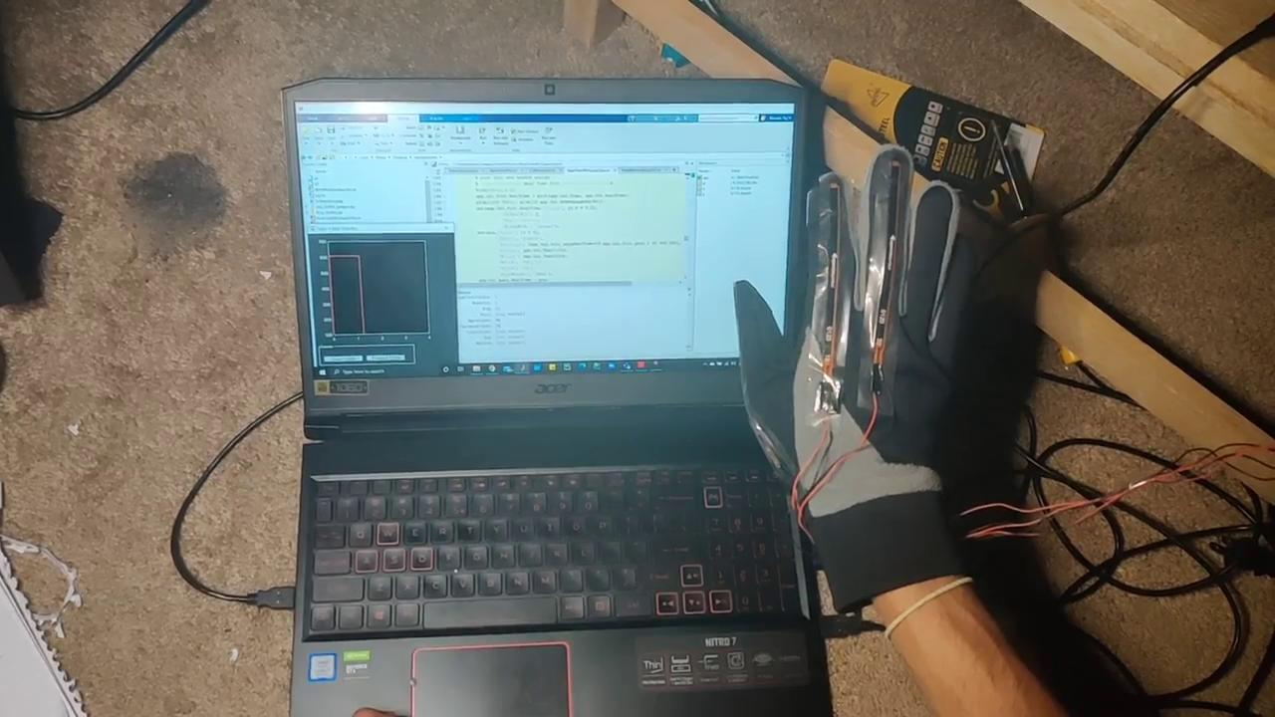
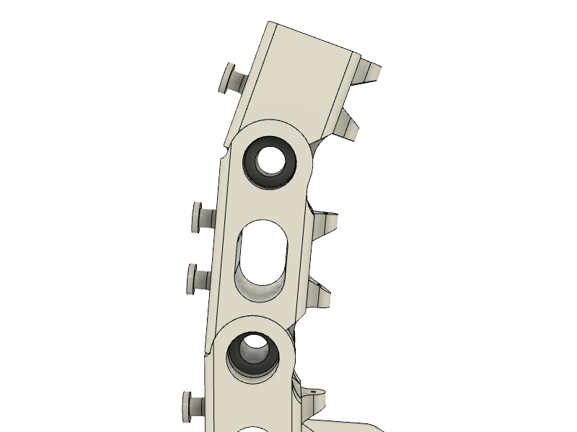
Design Challenges
Human hand proportion
Placement of servo
Limited servo motion - 0 ~ 165 deg - effective pull length ~ 28mm
Sensitivity of servo motors
Fixing flex sensor to gloves
Thresholding for different hand sizes
Friction in 3D printed parts

Slide 5
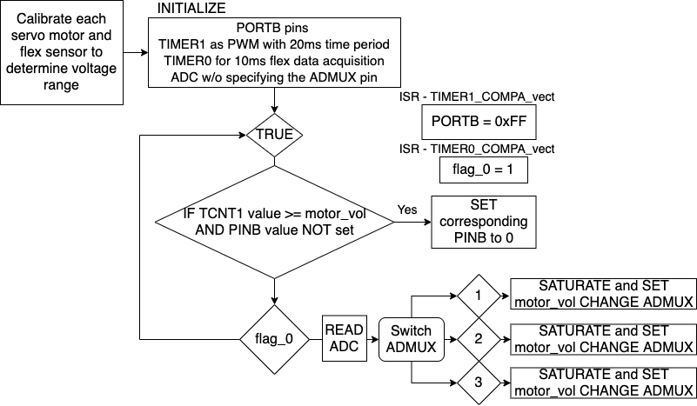
Pseudo chart

Slide 6
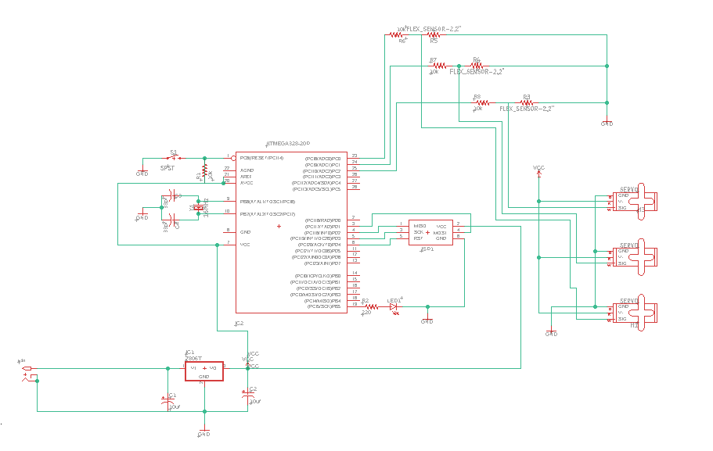
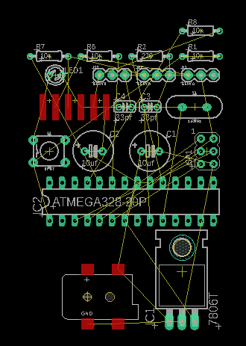
Schematic diagram

Slide 7
Next steps and Lesson learned
Next work? Why ?
Wireless data transfer.
Increasing the gain by using better torque motor.
Custom PCB and power distribution.
Building the platform.
Lessons learned and What to change?
Programming with Embedded C and ring-buffers in real-time applications.
Design challenges
Kinematic study
Interface for different user

Slide 8
Questions?
Thank you!

Slide 9
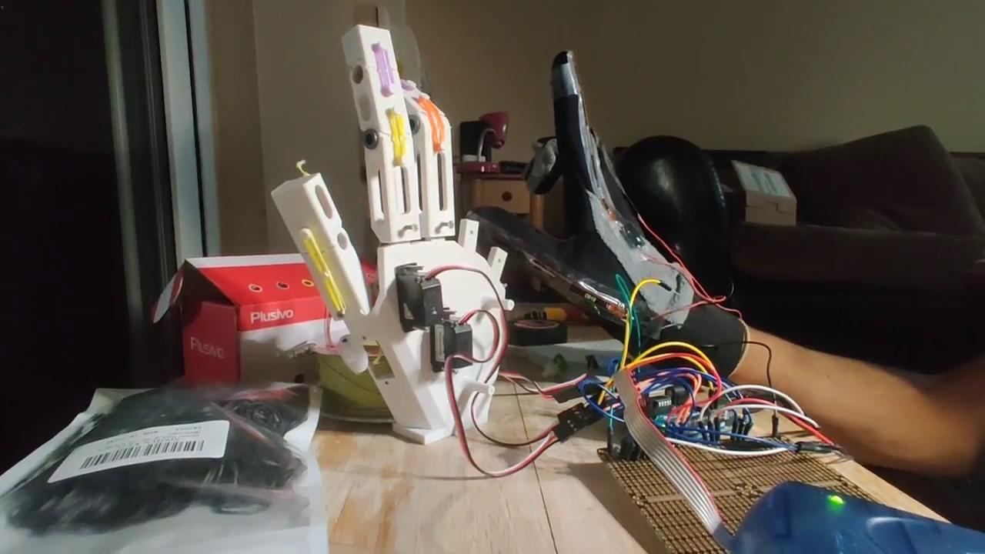
Demo-ish

